Slide 1
Introduction to Spring Boot

Slide 2
What is Spring Boot?
Spring Boot is built on top of Spring Framework to ease bootstrapping and development of new spring Applications.
Spring boot helps to build, package and deploy a Spring web application with minimal or no xml configurations.
Spring web application can be delivered as a FAT-JAR file to run as a stand alone Spring application.
It helps to avoid lot of boilerplate code and configuration to improve Development, Unit Test and Integration Test Process.

Slide 3
Why Spring Boot?
Eases spring set up
Avoids xml configuration completely
Combines some existing annotations to a single annotation.
For eg: @SpringBootApplication =@Configuration + @Componentscan + @EnableAutoConfiguration
Eases Dependency management
Uses Spring Boot’s intelligent collection of dependencies – Bill of materials (BOM) – The match up of various frameworks with the compatible versions.
For Eg: Spring-boot-starter-web
Configures the resources based on what is found in the class path.
Spring MVC with default:
We can include the Maven dependencies for persistence and a db. If we did not include then Spring Boot configures Hibernate as a JPA provider with an HSQLDB database by default.
Embedded Servlet Container Support

Slide 4
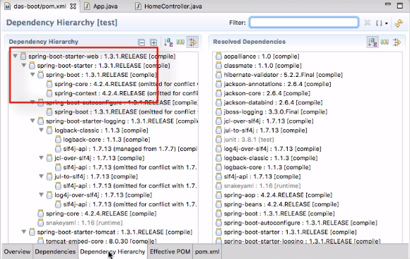

Slide 5
Spring Boot Releases
Latest Release : Spring Boot 1.3.3. You require minimum Spring Framework 4.2.2 for this version.
The latest stable release is Spring Boot 1.3.2.

Slide 6
Spring Boot components
Spring Boot consists of the following components:
Starter
Combines a group of common or related dependencies into single dependency.
Spring Boot Starter simplifies project build dependencies.
Eg: For Spring mvc web application - Spring-boot-starter-web dependency
For JPA provider – Spring-boot-starter-data-jpa
For UI creation – Spring-boot-thymeleaf, etc
Auto Configurator
By including the spring-boot-starter-web jar, Spring Boot Auto Configurator will sets view resolvers, sets static resources etc. automatically.
@SpringBootApplication annotation at class level, then Spring Boot Auto Configurator will automatically add all required annotations to Java Class ByteCode.

Slide 7
Spring Boot components – contd.
CLI
Spring Boot CLI(Command Line Interface) is a Spring Boot software to run and test Spring Boot applications from command prompt.
CLI internally uses Spring Boot Starter and Spring Boot Auto Configurator components to resolve all dependencies and execute the application.
Actuator
Spring Boot Actuator automatically provides hostname as “localhost” and default port number as “8080”. We can access this application using “http://localhost:8080/” end point.

Slide 8
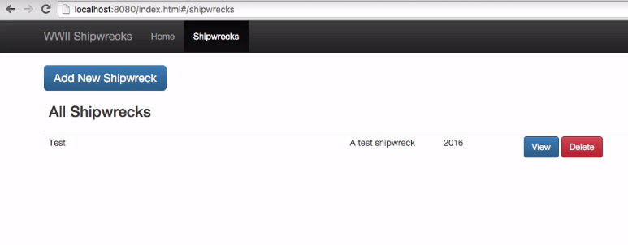
Developing Web application using Spring Boot
UI

Slide 9
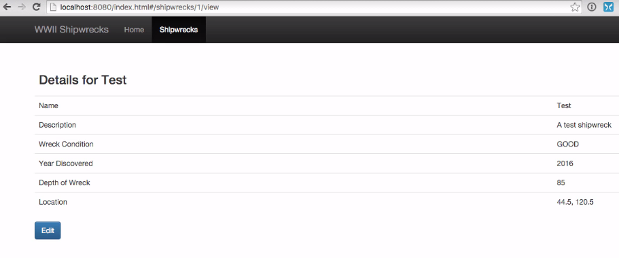

Slide 10
Prerequisites
Java 1.6 and above
Maven
An IDE like Eclipse or Spring STS

Slide 11
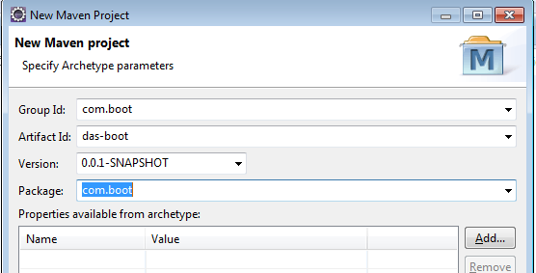
Create a Maven project with the default workspace location and select org.apache.maven.archetypes maven-archetype-quickstart 1.1 as the Archetype. Below are the Archetype parameters.

Slide 12
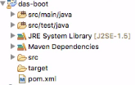
A maven project gets created with the below folder structure.

Slide 13
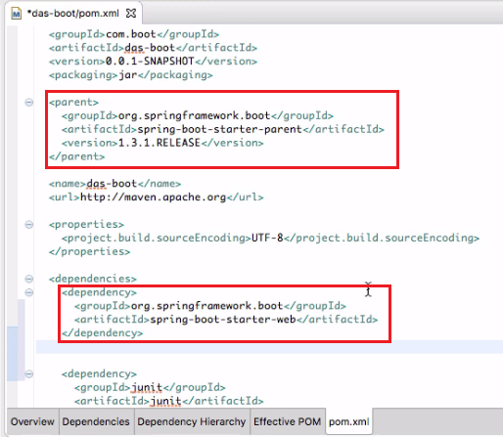
Modify the pom.xml to add the parent and dependency for Spring boot. This looks after the dependency management.

Slide 14
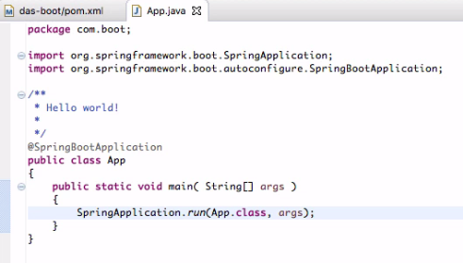
App.java class will be created by the Maven quickstart archetype in the com.boot package. Modify the contents of the class as below.

Slide 15
How does spring boot work?
Integrate with Javascript based UI
https://github.com/dlbunker/ps-spring-boot-resources.git and copy the static resources to src/main/resources/public folder
Integrate with Javascript based UI
https://github.com/dlbunker/ps-spring-boot-resources.git and copy the static resources to src/main/resources/public folder
public static void main(…) | Starts java and then the application
@SpringBootApplication | A convenience annotation that wraps other commonly used annotations
@Configuration @EnableAutoConfiguration @ComponentScan | Spring configuration on start up Auto configures frameworks Scans project for Spring components
SpringApplication.run(…) | Starts Spring, creates spring context, applies annotations and sets up container

Slide 16
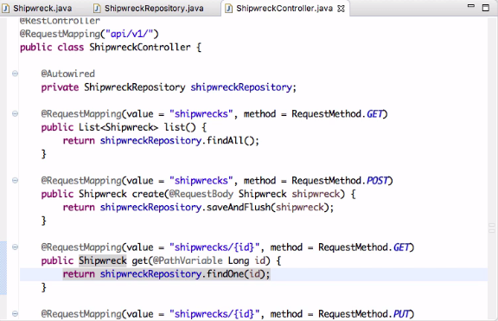
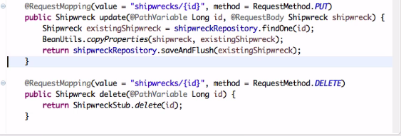
Create the controller, model and repository packages under the com.boot package.
Create a ShipWreckController.java class in the controller package as below.

Slide 17
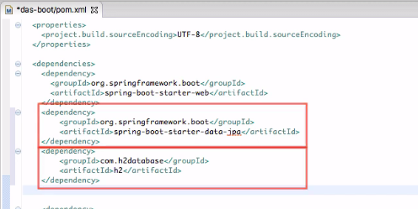
Add the dependencies for JPA and H2 DB integration.

Slide 18
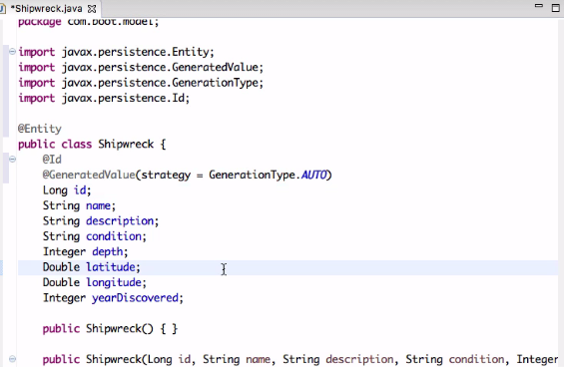
Create a Shipwreck.java in the model package.

Slide 19
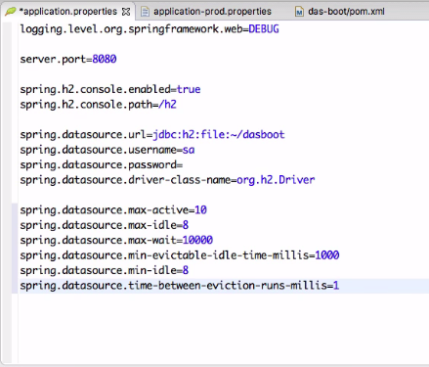
The server, datasource properties, logging levels, common pooling properties specific to the application can be given in the application.properties file.

Slide 20
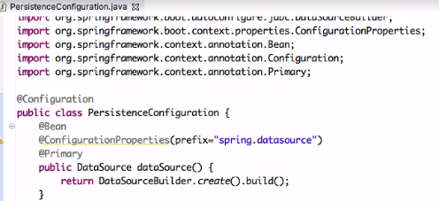
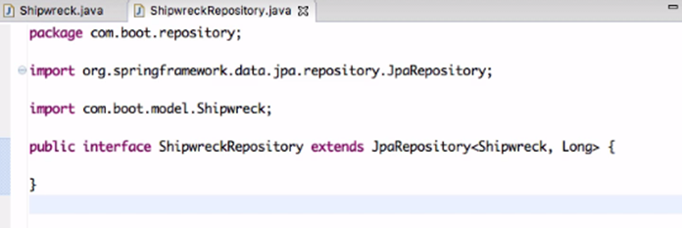
Create a ShipwreckRepository.java in the repository package.

Slide 21
Run the App.java class as Java Application.
In the browser, type http://localhost:8080 and hit enter.
Now our we spring boot web application is built.
For Cassandra db, following dependencies have to be included,
Spring-data-Cassandra, Cassandra-driver-core and Cassandra-driver-mapping

Slide 22
Limitations of Spring Boot
Although it is very easy to create Web applications from scratch using Spring Boot, the process to convert an existing legacy Spring framework project to Spring Boot Application is a time consuming task.

Slide 23
References
https://app.pluralsight.com - Creating Your First Spring boot Application By Dan Bunker
https://app.pluralsight.com/player?course=spring-boot-first-application&author=dan-bunker&name=spring-boot-first-application-m2&clip=6&mode=live

Slide 24
Happy Spring Boot Learning! Thank you !!!

